Slide 1
Support Vector Machine Active Learning for Image Retrieval
Simon Tong
Department of Computer Science
Stanford University
Sanford, CA 94305
Edward Chang
Electrical & Computer Engineering
University of California
Santa Barbara, CA 93106
Presented By: Harmanjot Kaur Rajpal
Shashank Gaikawari

Slide 2
Outline:
Abstract
Terminology
Introduction
How SVM Works?
SVM
Version Space
Active Learning
Image Characterization
Experiment
Related Work
Conclusion
Future Work

Slide 3
Abstract
With Image databases, it is difficult to specify queries directly and explicitly. Relevance feedback is often a critical component when designing image databases.
Relevance feedback interactively determines a user’s desired output or query concept by asking the user whether proposed images are relevant or not.
For this to be effective, it must grasp a user’s query concept:
Accurately
Quickly
Also, only by asking the user to label a few number of images.
The paper proposes the use of a support vector machine active learning algorithm for doing such relevance feedback for image retrieval.
This algorithm selects the most informative images to query a user and quickly learns a boundary that separates the images that satisfy the user’s query concept from the rest of the dataset.

Slide 4
Terminology
Relevance Feedback: It take the results that are initially returned from a given query, to gather user feedback, and to use information about whether or not those results are relevant to perform a new query.
Query Concept: It allows user to implicitly inform a database of his or her desired output.
SVM: Support Vector Machines
Active Learning: able to interactively query the user to obtain the desired outputs.
Image Retrieval: Fetching images from the database that contains thousands of images.

Slide 5
Introduction
Since an Image query is hard to articulate, and articulation can again be subjective, there is a need for a way to implicitly inform a database of his or her desired output or query concept.
To address this requirement, relevance feedback can be used as a query refinement scheme to derive or learn a user’s query concept.
The user labels a few images as either ‘Relevant’ or ‘Not Relevant’. Based on the labels, another set of images are provided to the user for labelling. After a couple of rounds, the database returns him a set of images with the desired output.
This query concept learner can be seen as a pool-based active learning.
Most machine learning algorithms are passive in the sense that they are generally applied using a randomly selected training set. The key idea with active learning is that it should choose its next pool-query based upon the past answers to previous pool-queries.
Since most users do not wait around to provide a great deal of feedback. In this study, we propose using a support vector machine active learner (SVM_{Active}) to achieve these goals. SVM_{Active} combines active learning with support vector machines (SVMs). SVMs have met with significant success in numerous real-world learning tasks.

Slide 6
How SVM_{active} works?
It works by combining the following three ideas:
SVM_{Active} regards the task of learning a target concept as one of learning a SVM binary classier.
Captures the query concept by separating the relevant images from the irrelevant images.
SVM_{Active} learns the classier quickly via active learning.
The active part of SVM_{Active} selects the most informative instances with which to train the SVM classifier.
This step ensures fast convergence to the query concept in a small number of feedback rounds.
3. Once the classifier is trained, SVM_{Active} returns the top-k most relevant images.

Slide 7
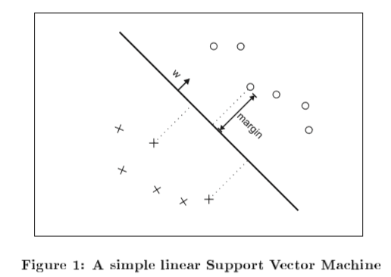
Support Vector Machines
SVM constructs a hyperplane (or set of hyperplanes), which can be used to for classification or regression.
Hyperplanes separate the training data by a maximal margin (see Fig. 1).
In this paper, hyperplane separates relevant and non relevant images.
All vectors lying on one side of the hyperplane are labeled as -1, and all vectors lying on the other side are labeled as 1.
The training instances that lie closest to the hyperplane are called support vectors.

Slide 8

SVM (Continued..)
SVMs allow one to project the original training data in space X to a higher dimensional feature space F via a Mercer kernel operator K.
In other words, we consider the set of classifiers of the form:
When f(x) ≥ 0 we classify x as +1, otherwise we classify x as -1.
When K satisfies Mercer's condition, we can write: K(u;v) =Ф(u). Ф(v) where, Ф: X -> F and “.” denotes an inner product. We can then rewrite f as
Thus, by using K we are implicitly projecting the training data into a different (often higher dimensional) feature space F.
Two commonly used kernels are:
polynomial kernel which induces polynomial boundaries of degree p in the original space X.
the radial basis function kernel which induces boundaries by placing weighted Gaussians upon key training instances
In the remainder of this paper we will assume that the modulus of the training data feature vectors are constant x_{i} , || Ф (x_{i})|| = λ for some fixed λ.
The quantity || Ф (x_{i})|| is always constant for radial basis function, so assumption has no effect on this kernel

Slide 9


Version Space
Given a set of labeled training data and a Mercer kernel K, there is a set of hyperplanes that separate the data in the induced feature space F. This set of hyperplanes is called the version space.
Possible hypothesis is given as
Where, parameter space W is simply equal to F.
The Version space, V is then defined as:
That since H is a set of hyperplanes, there is a bijection (an exact correspondence) between unit vectors w and hypotheses f in H. Thus we will redefine V as:
Version space exists in the training data as linearly separable in the feature space. This could be achieved in two ways
The feature space often has a high-D and results in the data set being linearly separable.
It is possible to modify any kernel so that the data becomes linearly separable.

Slide 10

Version Space (Continued..)
SVMs find the hyperplane that maximizes the margin in the feature space F.
This helps us to find the point in the version space that maximizes the minimum distance to any of the delineating hyperplanes.

Slide 11
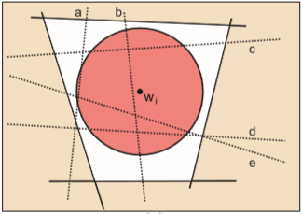
Active Learning
In pool-based active learning we have a pool of unlabeled instances.
It is assumed that the instances x are independently and identically distributed according to some underlying distribution F(x) and label according to some conditional distribution P(y|x).
An unlabeled pool U, an active learner has three components: (f ,q , X).
f is a classifier, f : X -> {-1,1} trained on the current set of labeled data X (and possibly unlabeled instances in U too).
q(X) is the querying function that, given a current labeled set X, decides which instance in U to query next.
The active learner can return a classifier f after each pool-query (online learning) or after some fixed number of pool-queries.
The main difference between an active learner and a regular passive learner is the querying component q.
We wish to reduce the version space as fast as possible. One good way of doing this is to choose a pool-query that halves the version space.
The hyperplane that is closest to w_{i} is b, so we will choose to query b.

Slide 12
Active Learning Algorithm
Our SVM_{Active} system performs the following for each round of relevance feedback:
Learn an SVM on the current labeled data.
If this is the first feedback round, ask the user to label twenty randomly selected images. Otherwise, ask the user to label the twenty pool images closest to the SVM boundary.
After the relevance feedback rounds have been performed SVM_{Active} retrieves the top-k most relevant images:
Learn a final SVM on the labeled data.
The final SVM boundary separates “relevant” images from irrelevant ones. Display the k “relevant” images that are farthest from the SVM boundary.

Slide 13
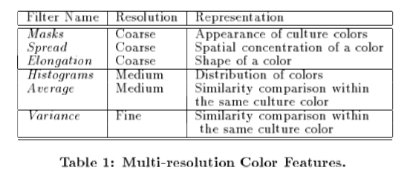
Image Characterization
We characterize images by two main features:
Color
Texture
Color
Color cultures are limited to 11. (Black, white, red, yellow, green, blue, brown, purple, pink, orange and grey)
Divide color into 12 color bins (11 culture colors + 1 outliers)
At the coarsest resolution, we characterize color using 12 bits
At finer resolution, we record 8 additional features for each color:
Color histograms
Color means
Color variances
Shape characterization: elongation and spreadness

Slide 14
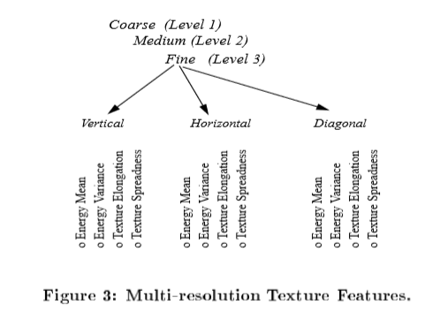
Image Characterization(Continued..)
Texture features are characterized in terms of structurdeness, orientation and scale(coarseness).
We use Discrete Wavelet Transformation (DWT) using quadrature mirror filters.
Each wavelet decomposes a 2-D image and yields four sub images
A 1/2 *1/2 scaled down image of input image
Wavelets in three orientations (horizonal, vertical and diagonal)
Decomposing the scaled-down image further, we obtain tree-structured or wavelet packet decomposition.
Every sub-image contains information of a specific scale and orientation and also returns spatial info. We can obtain 9 texture combinations.
Based on the above, given an image, we can extract texture and color to produce 144-D vector of numbers.

Slide 15
Experiments
Four Category Set
The 602 images in this dataset belong to four categories: architecture,
flowers, landscape, and people.
Ten Category Set
The 1277 images in this dataset belong to ten categories: architecture, bears, clouds, flowers, landscape, people, objectionable images, tigers, tools, and waves
In this set, a few categories were added to increase learning difficulty.
Like The tiger category contains images of tigers on landscape and water backgrounds to confuse with the landscape category.
Fifteen Category Set
The 1920 images contain ten categories in the above dataset and elephants, fabrics, fireworks, food and texture.
We added elephants with landscape and water background to increase learning diffculty between landscape, tigers and elephants.

Slide 16
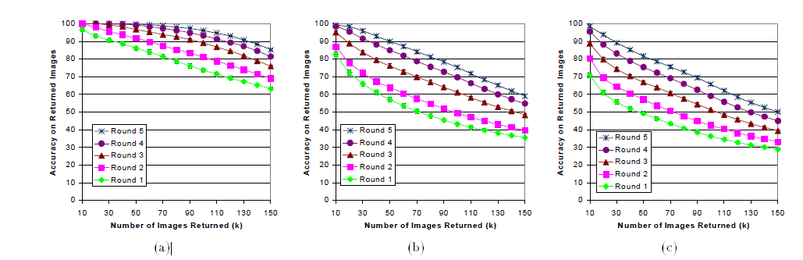
Top k-accuracy for Four Category Set
Top k-accuracy for Ten Category Set
Top k-accuracy for Fifteen Category Set
For example, after five rounds of querying it attains 99%, 84% and 76% accuracy on the top-70 results for the three different sizes of data sets respectively.

Slide 17
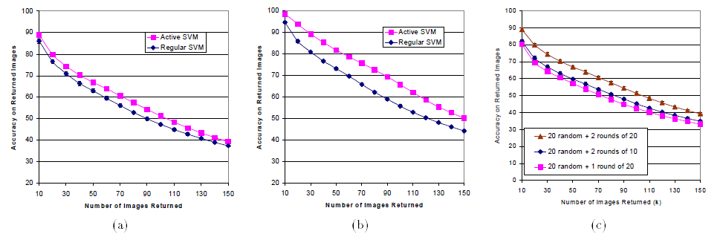
Active and regular passive learning on the fifteen-category dataset after three rounds of querying.
Active and regular passive learning on the fifteen-category dataset after three rounds of querying.
Comparison between asking ten images per pool-query round and twenty images per pool-querying round on the fifteen-category dataset

Slide 18
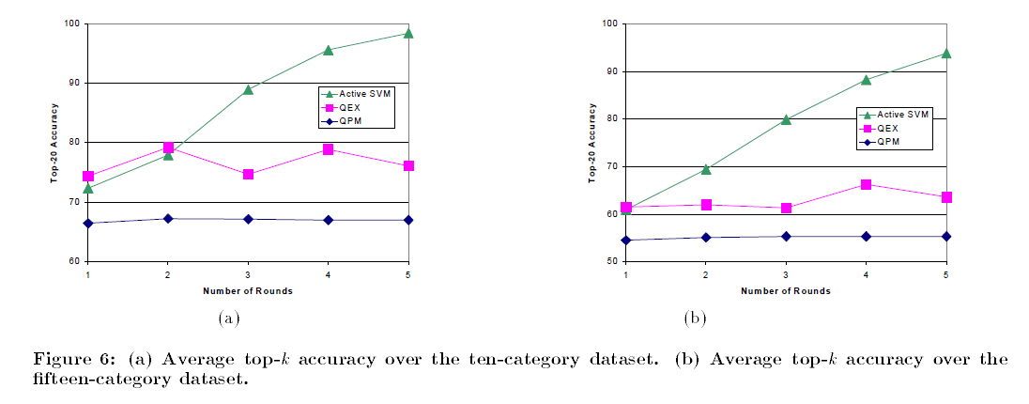
We also compared SVM_{Active} with two traditional query refinement methods: query point movement (QPM) and query expansion (QEX).
In this experiment, each scheme returned the 20 most relevant images after up to five rounds of relevance feedback.
To ensure that the comparison to SVM_{Active} was fair, we seeded both schemes with one randomly selected relevant image to generate the first round of images
Traditional information retrieval schemes require a large number of image instances to achieve any substantial refinement.

Slide 19
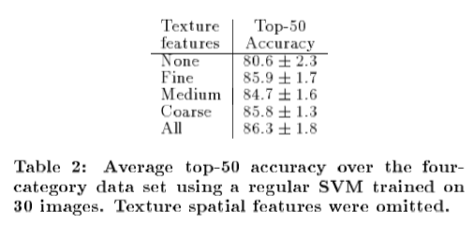
Experiment(Continued..)

Slide 20
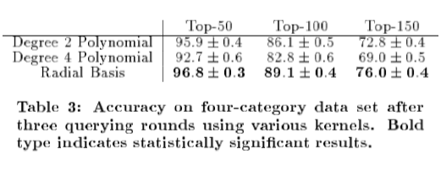
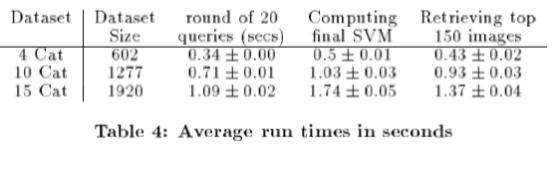
Experiment (Continued..)

Slide 21
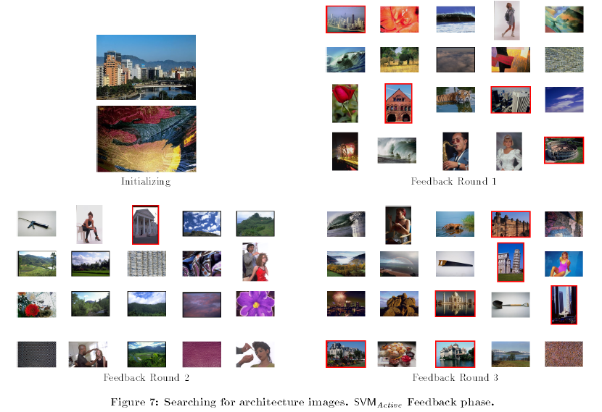
SVM_{Active} Feedback Phase

Slide 22
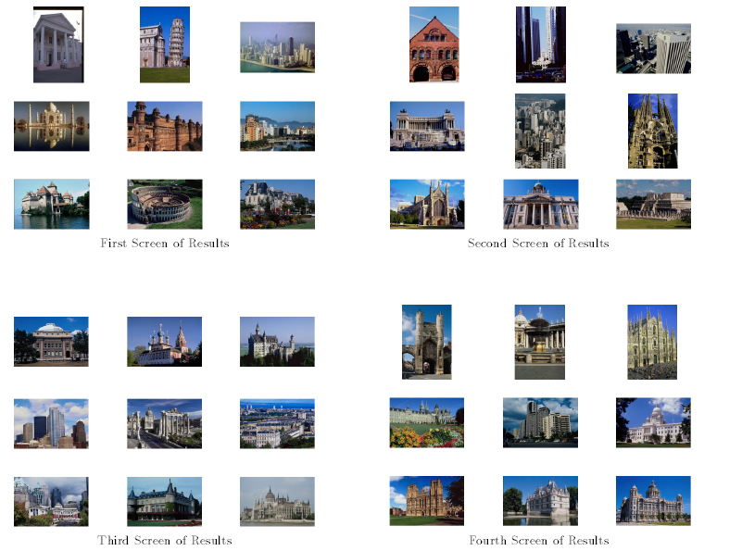
SVM_{Active} Retrieval Phase

Slide 23
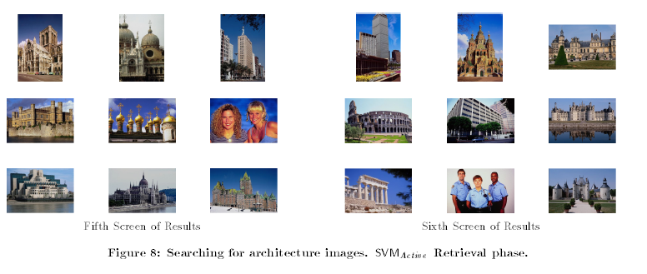
SVM_{Active} Retrieval Phase(Continued..)

Slide 24
Related Work
Lewis and Gale (1994) focused on the text classification task and introduced uncertainty sampling using logistic regression and also decision trees. SVM_{Active's} querying method is essentially the same as their uncertainty sampling method.
Relevance also perform non random sampling. A study puts these query refinement approaches into three categories.
Query reweighting and query point movement: Both use nearest-neighbor sampling. They return top ranked objects to be marked by the user and refine the query based on the feedback.
Query expansion: uses multiple-instances sampling approach. The samples of the next round are selected from the neighborhood (not necessarily the nearest ones) of the positive labeled instances of the previous round.
The PicHunter system uses Bayesian prediction to infer the goal image, based upon the users’ actions. The system shows that employing active learning can drastically cut down the number of iterations (up to 80% in some experiments).

Slide 25
Conclusion
Active learning with SVM can provide a powerful tool for searching image databases, outperforming a number of traditional query refinement schemes.
SVM_{Active} not only achieves consistently high accuracy on a wide variety of desired returned results, but also does it quickly and maintains high precision when asked to deliver large quantities of images.
The running time of our algorithm scales linearly with the size of the image database both for the relevance feedback phase and for the retrieval of the top-k images.
SVMactive is only practical when image database contains a few thousand images, authors are looking for ways for storing to larger sized databases

Slide 26
Future Work
Authors are also finding ways for using experiment output to explore feature space until single relevant image is identified.
An alternative approach for finding a single relevant image is to use another algorithm to seed SVM_{Active}. For example, the MEGA algorithm that authors have developed in a separate study does not require seeding with a relevant image.
Transduction can be combined with active learning to provide improvement in performance for the task.

Slide 27
Thank You.
Any Questions?

